Slide 1
Medical Records Audit Automation Tool
Interns: Rutik Makwana, Anudeep Verma, Nikhil Kumar Pandey
Mentors : Bharathi , Raviraj , Bhuvan, Sriram, Hari, Amarendra

Slide 2
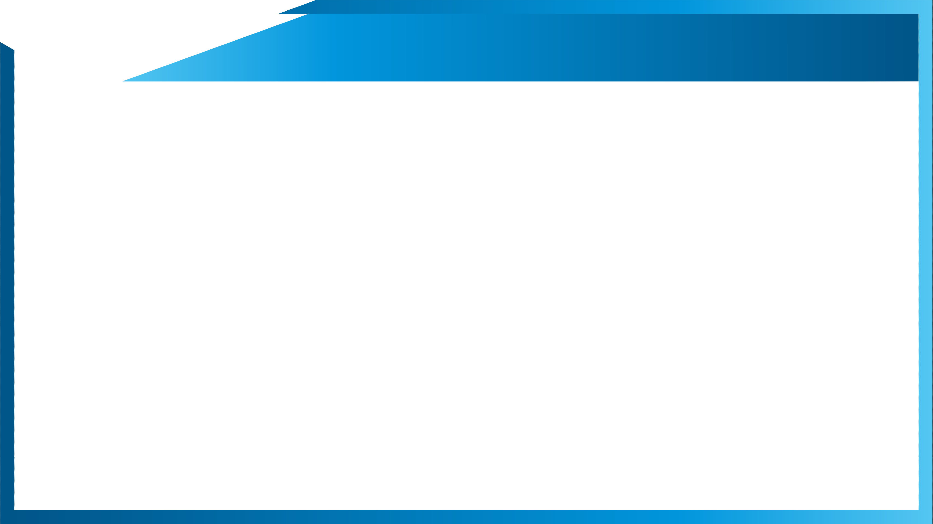


Agenda
Problem Statement & Objective
Milestones & Schedules
Solution Architecture
Methodology
Results & Discussion
Tool Benefits & Enhancement Ideas
Release Information
Demo
Notes:
Our Agenda for today’s presentation is as below- starting from the problem, to milestones we achieved as we progressed, solns & approaches we found out, current status and future works to be done. In the end, we will have a demo of our work.

Slide 3
Problem Statement & Objective
Problem Statement:
Extract the data from Claim forms and validate if Medical Record (MR) is found for a claim in WCF portal.
Objective:
Automate the process of checking the correct medical record (present or not) for a manually processed claim in WCF portal.
Extract the data from the medical records using OCR engine and match it with the given data to verify its correctness
Extraction required fields from WCF Claim forms and feed it to the Bot
Notes:
So, the problem statement given to us goes like this - to automate the process of checking if the correct medical record is attached by the patient or not in the WCF portal, which till now had to be manually checked and processed.
For this problem statement, We defined our objectives as following:
automate claims processing by receiving the patient’s details from WCF Bot, namly- name, service date, billing npi, dob, dcn no, hc id.
Search and match the pdfs to verify if it is a medical records
Return a bolean value (T/F) if medical record is present or not.

Slide 4
Milestones & Schedules
Milestone 1
Milestone2
Milestone3
Milestone4
Start Date:27/05/2022
End Date:10/06/2022
Read business slides
Knowledge Transfer
Work on collab for dummy data
Successfully extracted text from dummy data
Outcome:
Understood the problem statement. Successfully implemented different approaches in dummy data. Started working with original data.
Start Date:11/06/2022
End Date:24/06/2022
Explored multiple approaches
Tried to implement research papers.
Finalized the approach giving best results.
Outcome:
After exploring different approaches finalized the approach. Successfully extracted the required data.
Start Date:25/06/2022
End Date:01/07/2022
Started Working on the automation process.
Solved the problems.
Initial demo and collect feedback
Successfully created a full working model.
Outcome:
Successfully created a working model of the automation process. Had an initial demo and feedback session.
Start Date:02/07/2022
End Date:15/07/2022
Model finalization
Feedback implementation
Improve performance using multiprocessing.
Final Demo
Outcome:
Improving the performance of the automation model using multiprocessing and reducing wait time and finalize the project.
Notes:
In the span of working with Legato, We have achieved three milestones up till now,
Started with understanding the Problem Statement and Knowledge transfer
explored various approaches to extract data,
Then automated the WCF portal for searching and finally summarizing everything to a working model after loads of debugging.
Now, We aim to achieve the 4th milestone as well in the coming 2 weeks.

Slide 5
Solution Architecture
Bot writes data in excel sheet
Script takes claim data from excel
Opens and login WCF filenet portal
Searches for the attachments (Rule-Based)
Download if present
Extract data and Match the required fields
Update the excel sheet on the presence of medical record
OCR Engine Architecture (Click here)
Rule-Based Algorithm (Click here)
Notes:
As you saw in previous figure, our WCF automation approach starts with the bot writing the data of patient into a excel, from their our program reads it and open the WCF portal, logins and searches using different field which we will explain in detail later, download them and match certain field to check if it’s a medical attachment. Finally, We write True or False if it’s a medical attachment in another excel which the WCF Bot will read it and proceed further.
As you saw in previous figure, our WCF automation approach starts with the bot writing the data of patient into a excel, from their our program reads it and open the WCF portal, logins and searches using different field which we will explain in detail later, download them and match certain field to check if it’s a medical attachment. Finally, We write True or False if it’s a medical attachment in another excel which the WCF Bot will read it and proceed further.

Slide 6
Methodology
WGS Bot writes the required fields such as DCN, HCID, Patient Name, DOB, Service Date, Creation Date, Provider’s Name and NPI from WGS into an excel sheet.
“Audit Automation Tool” takes the excel sheet as an input, for each record in the input it runs a rule-based algorithm to download the attachment (Claim form or Medical Record).
OCR Engine runs on the above form to determine whether if it is a valid medical record or not.
Tool Overview:
After taking the input from the Excel sheet, Our Program first opens the WCF filenet website and performs login operation by providing our username and password.
After Login, our program enters the filenet portal and select the claims corro extended search option in the dropdown.
Then an Extensive Search operation is performed to filter out the correct records for the claim data which is currently taken as input.
Notes:
As you saw in previous figure, our WCF automation approach starts with the bot writing the data of patient into a excel, from their our program reads it and open the WCF portal, logins and searches using different field which we will explain in detail later, download them and match certain field to check if it’s a medical attachment. Finally, We write True or False if it’s a medical attachment in another excel which the WCF Bot will read it and proceed further.

Slide 7
Results
Notes:
Good evening everyone, I am Anudeep and I will talk about the results which we got and this time we are back with numbers, stats and speed enhancements.
All Y-axis values in graphs are in minutes.
On the left, you can see that the sample average time consumed for three different ways to check for medical records in WCF portal. 1st- manually, 2nd automation without multithreading, and 3rd automation with multithreading. We have reduced the time for whole automation process, starting from login to reporting if medical record present or not, by half.
In automation without multithreading (Blue bar), we are checking on 5 pages instead of 2 pages, so it takes on average 6 min per pdf instead of 3 min per pdf
In automation with multithreading (Green bar), we get on average 3 min per pdf which is much faster than normal automation.
On the right, you can see the time distribution which we recorded using python while trying a bulk run on 51 pdfs
This small pie chart shows time consumption for each batch which we download
73% is just for downloading
Only 23% is for checking document

Slide 8
Benefits & Enhancement Ideas
We got the overall accuracy of 86.27% when we cross checked above reported outcomes with our downloaded pdfs. [Link]
Precision = 100%, Recall = 65%
Notes:
20: Ops team 13 7 (6+1)
We got accuracy of 86.27% when we cross check the results manually
Precision means out of medical results we predict, how many were actually medical and that is 100%
13 out of 13 were medical, so 100%
Recall means out of all medical record existing in 51 dataset, how many we are correctly getting as medical record and that is 65%
Out of 51, 20 were medical, and we get 13 as medical, so 13/20= 65%
65 comes as
Total time right from the starting login to verifying medical records
Avg time 6 min
Avg time 4.5 min

Slide 9
Challenges & Enhancements
Challenges
Access: With the limited access to West claims and could get docs for East and Central claims like the Ops teams. They easily got docs using DCN only, saving lot of time in opening and downloading.
IBM daeja ViewOne: We were not able to download the pdf which showed IBM daeja ViewOne written (7 docs, lost on accuracy by 12%)
Future Enhancement Ideas
GPU: EasyOCR library(for text extraction) is much faster if we use GPUs instead of CPU
Text extraction: try to integrate it for claims form used with it to process the claims
Better browser: Shift the WCF to faster browser like Chrome.
Download & Check 5 Pages: We had to check all 5 pages to verify, time consuming
IE & Java issues: only one of us was able to open and download
Notes:
In short, for the span of time we worked on this project, our main focus was on the accuracy , since that is achieved, pdf downloading part can be optimized in future

Slide 10
Demo
Notes:
Here, I would like to handover the command to Rutik for a short demo of our work

Slide 11
Charter
Documents Required:
Claims Forms in PDF
Medical Forms
Programming Language:
Python (Scripts in Jupyter & Spyder)
Libraries:
EasyOCR
Poppler
Tools:
Selenium
Browser Requirements:
Internet Explorer 32-bit driver
Java 32-bit
Sign-off Documents:
Presentation
User Guide
Code Base
SPOCS for further Proceedings:
1.
2.
Team Channel for the necessary documents:
Notes:
Firstly, we need some system requirements like anaconda, easyocr, poppler to work with medical and claims form. For webscrapping, we need Selenium and IE 32-bit driver , 32 because its faster. Java 32 bit is needed to open the claim form when we are inside WCF portel.
Got an overall accuracy of 74.56% while reporting if correct medical record is attached or not, comparing results with Ops teams results

Slide 12
Thank You!!
Notes:
We would like to appreciate the help of Sriram, Hari, Amrendra, Raviraj.

Slide 13
Back-Up Slides

Slide 14
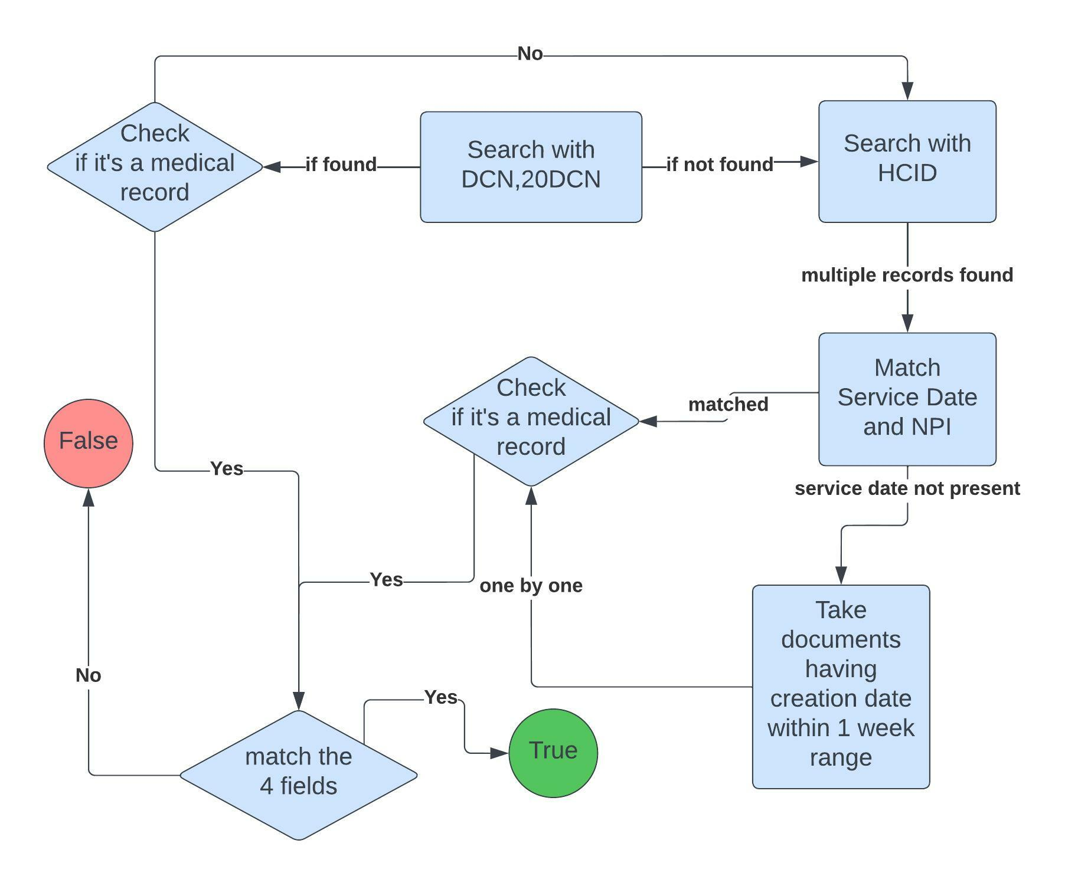
Rule-Based Algorithm
Go Back
Notes:
Mention one by one
Matched with claim details

Slide 15



OCR Architecture
Format Conversion
Image Pre-Processing
Information Extraction
Lines Detection
Defining contours
Index creation
4 fields for med record.
20 fields for Claim forms
Final Decision on Medical Record Presence
Go Back
Notes:
Now discussing about the soln achietecture, this slide presents a graphical representation of what we did for extracting required fields from claims form.
We first start with converting pdfs into the images and then apply some image processing approaches, i.e, crop out the boxes which contain required field.
then we use this image data and feed it into OCR to get the text inside it.
And lastly store the output data into the dictionary

Slide 16
Methodology
Overview:
WGS Bot writes the required fields such as DCN, HCID, Patient Name, DOB, Service Date, Creation Date, Provider’s Name and NPI from WGS into an excel sheet.
Our Python program takes the excel sheet as an input and performs the automation steps and gives a Boolean output (True or False) for each Claim entry whether a medical record is present or not.
Automation of WCF portal is performed using the Python Libraries- Selenium and Pyautogui and the Text Extraction from pdfs is performed using the libraries such as easyocr and pypdf2.
Details:
After taking the input from the Excel sheet, Our Program first opens the WCF filenet website and performs login operation by providing our username and password.
After Login, our program enters the filenet portal and select the claims corro extended search option in the dropdown.
Then an Extensive Search operation is performed to filter out the correct records for the claim data which is currently taken as input.
Notes:
As you saw in previous figure, our WCF automation approach starts with the bot writing the data of patient into a excel, from their our program reads it and open the WCF portal, logins and searches using different field which we will explain in detail later, download them and match certain field to check if it’s a medical attachment. Finally, We write True or False if it’s a medical attachment in another excel which the WCF Bot will read it and proceed further.

Slide 17
Approach (Text Extraction)
Overview:
Program reads the Claims pdfs and converts them to image pages.
Using OpenCV, we make the grid by tracing the horizontal and vertical lines and crop out the image in boxes containing information.
Required information lies at specific index of the made image boxes list.
We extract text from specific indexes using easyocr to get the required fields and form a dictionary for each patient form.
Details:
Different approaches were used for generalizing this method for every form but were unable to get do it (with good accuracy)
We changed the method of extraction to contour detecting, changing kernel sizings, removing horizontal and verticals lines and then extracting
Tried libraries other than Pytesseract library, for text extraction, to different – pdfplumber, easyocr, pdfminer, textract, PyPDF2, and then found out that easyocr has the best accuracy having a little higher runtime.
Finalized easyocr after discussion with the team. Successfully extracted the required data from the given Claim forms.
Notes:
As you saw in previous slide, in our initial 4 weeks we worked on data extraction and finalizing the approach.
So, detailed explanation goes like this -
there were two kinds of forms provided to us from which we needed to extract some required fields and following operations were performed to reach to solution.
Firstly, the program is converting the pdfs into images with some preprocessing and library, then it is cropping the boxes from the pdf with proper indexing by detecting horizontal and vertical lines in the form using opencv and taking out detected boxes with specific indexes with have the required fields.
Further, we use easyocr to extract text insides image boxes and storing the extracted data in the form of dictionary with Patient name as the key, so we can later get all information of particular person using just his/her name if needed further.

